Slide 1
Chapter 18
Query Processing and Optimization

Slide 2
Query Processing and Optimization
Scanner: identify language components.
keywords, attribute, relation names
Parser : check query system
Validation: check attributes & relations
Query tree (query graph) : internal representation
Execution strategy: plan
Query optimization : choose a strategy
(reasonably efficient strategy)
16-1
18-<number>

Slide 3
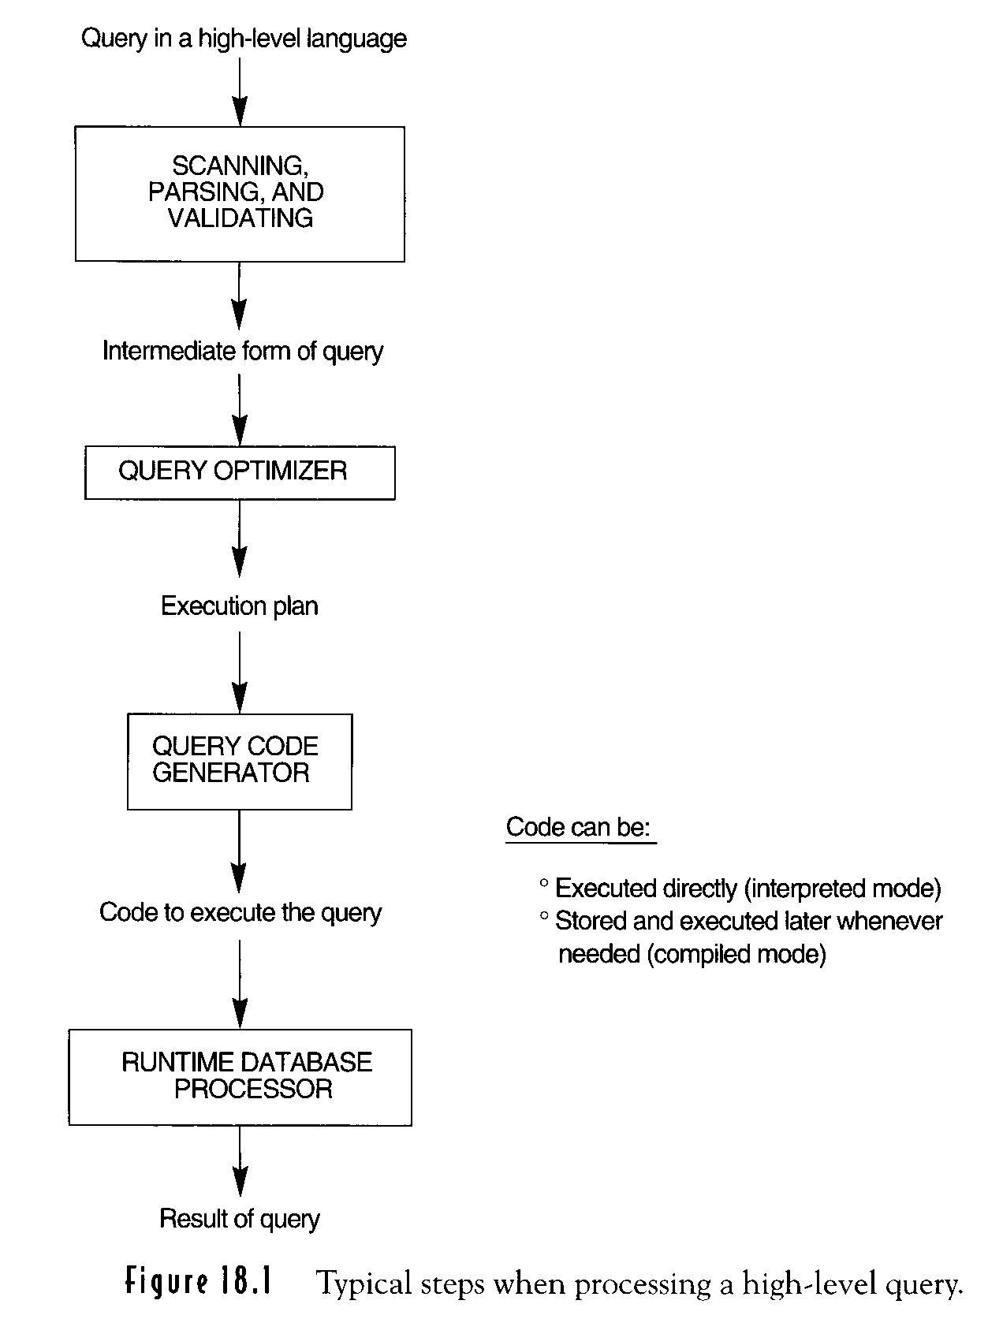
Figure 18.1 Typical steps when processing a high-level query
16-2
18-<number>

Slide 4
Translating SQL Queries into Relational Algebra
ΠLNAME, FNAME (σSALARY > C (EMPLOYEE))
SELECT LNAME, FNAME
FROM EMPLOYEE
WHERE SALARY > C
Query block
(SELECT MAX (SALARY)
FROM EMPLOYEE
WHERE DNO = 5 )
FMAX SALARY (σDNO = 5(EMPLOYEE))
Query optimizer: choose an execution plan for each block
  Uncorrelated nested query
  Correlated nested query
18-2-1
18-<number>

Slide 5
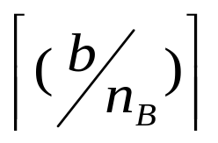
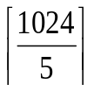
External Sorting
Sort-merge strategy
The Sorting phase
  Runs of file are read into main memory
  Runs are sorted using an internal sorting algorithm
  Runs are written back to disk as temporary sorted subfiles
  n_{R} : number of initial runs
  b : number of file blocks
  n_{B} : available buffer space
  n_{R} :
  Example: n_{B} : 5 blocks, b: 1024 blocks
  n_{B} = = 205 runs
18-2-2
18-<number>

Slide 6
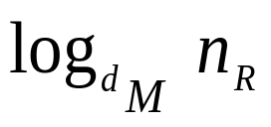
External Sorting
Sort-merge strategy (Cont.)
Merging phase
Sorted runs are merged during one or more passses.
d_{M} : degree of merging (d_{M} –way merging)
number of runs that can be merged together in
each pass
  d_{M} = min ( ( n_{B-1}), n_{R})
  number of passes = ┌ ┐
18-2-3
18-<number>

Slide 7
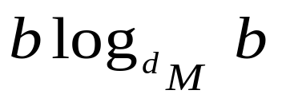
External Sorting
Sort-merge strategy (Cont.)
  Example: (2＊b + 2＊ )
  d_{M} = 4 ( 4-way merging)
205
1
1
1
1
…
1
52
1
4
…..
4
1
13
2
16
…..
13
4
3
64
…..
61
4
205
18-2-3
18-<number>

Slide 8
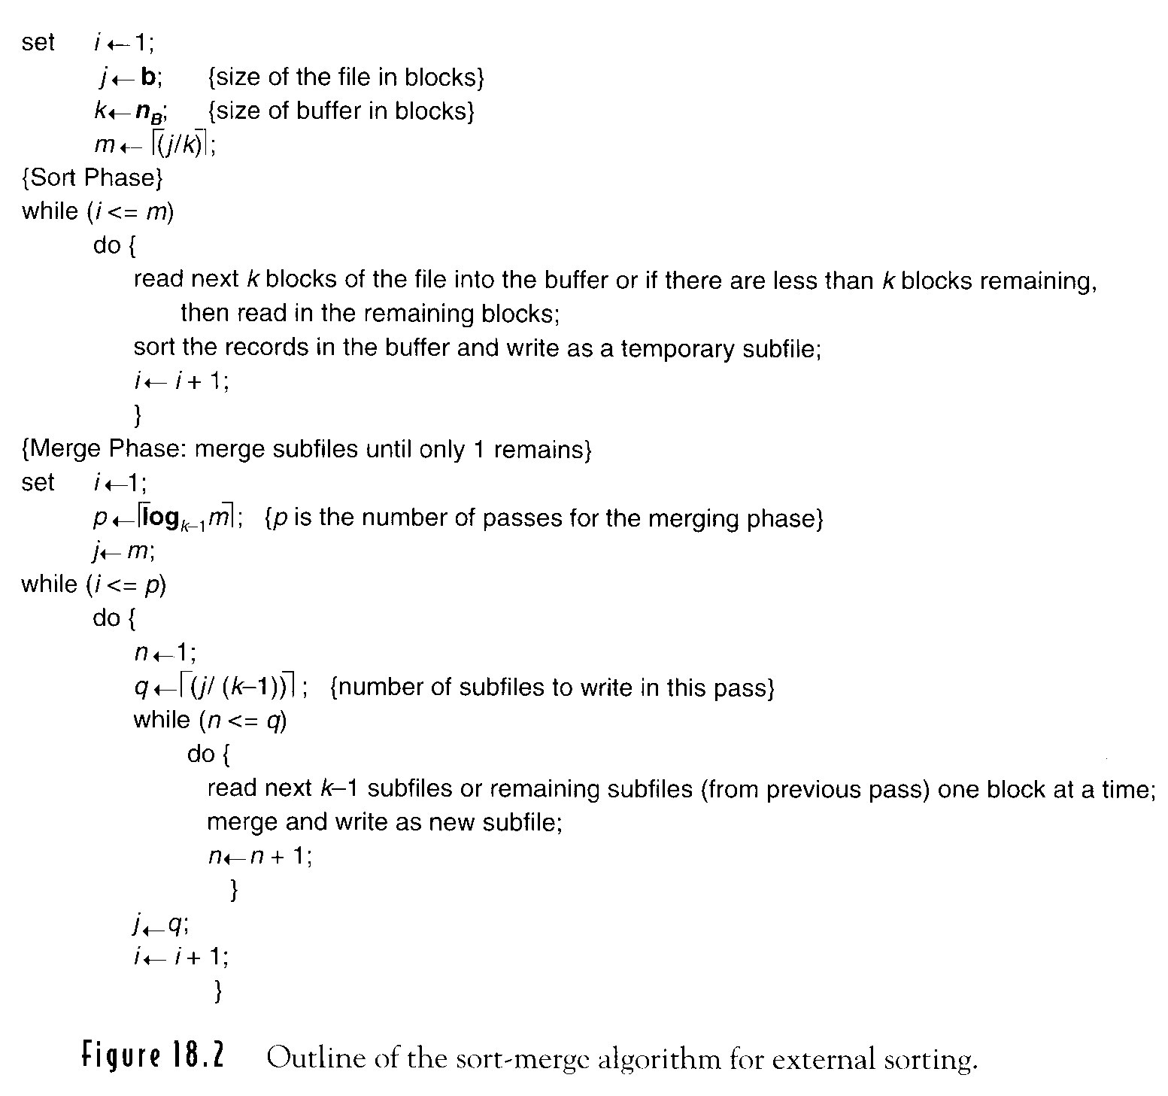
18-2-4
18-<number>

Slide 9
18-2-4
18-<number>

Slide 10
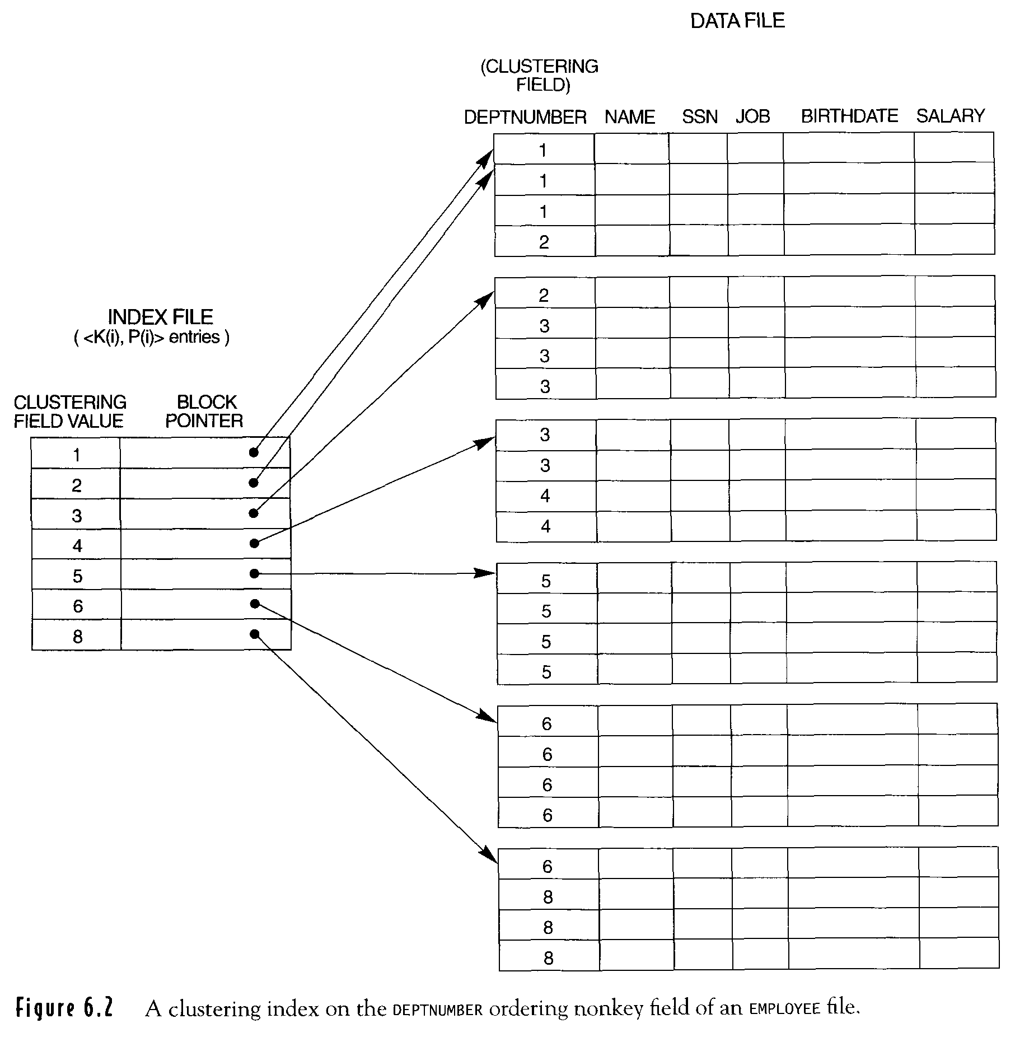
Clustering Index
Records of a file are
physically ordered on
a nonkey field.
clustering field

Slide 11
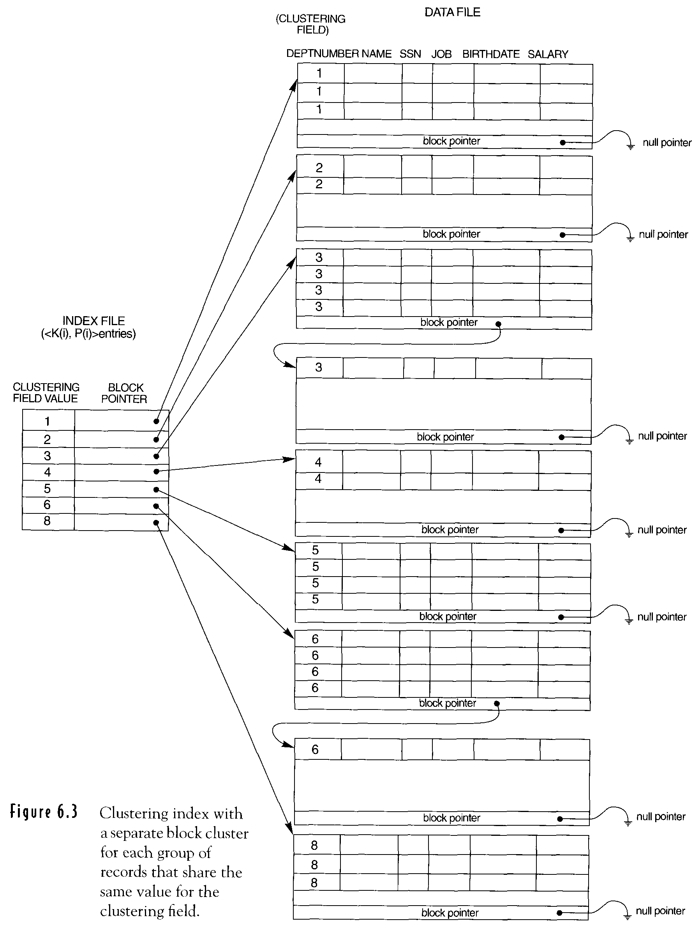
Reserve a whole block for
each value of clustering field

Slide 12
Basic Algorithms for Executing Query Operations
Implementing SELECT
(OP1) σ_{SSN=12345689} (EMPLOYEE)
equality comparison on key attribute
(OP2) σ_{DNUMBER > 5} (DEPARMENT)
nonequality comparison on key attribute
(OP3) σ_{DNO=5} (EMPLOYEE)
equality comparison on non key attribute
(OP4) σDNO=5 AND SALARY >30000 AND SEX=F(EMPLOYEE)
conjunctive condition
(OP5) σ_{ESSN=123456789 AND DNO=10} (WORKS_ON)
conjunctive condition and composite key
16-3
18-<number>

Slide 13
Search Methods for Selection file scans / index scans
S1. Linear Search (brute force)
S2. Binary Search
SSN=123456789 (OP1)
ordering attribute for EMPLOYEE
S3. Use primary index or hash key (single record)
SSN=123456789 (OP1)
Primary index or hash key
S4. Use primary index (multiple records)
DNUMBER>5 (OP2)
primary index
S5. Use clustering index (multiple records)
DNO=5 (OP3)
clustering index
Locate
Find proceeding subsequent
16-4
18-<number>

Slide 14
Search Methods for Selection (Cont.)
file scans / index scans
S6. Use secondary (B⁺_tree) index
S7. Conjunctive Selection
There does exist a simple condition that permits use of S2-S6.
DNO=5 AND SALARY > 30000 AND SEX=F (OP4)
S8. Conjunction Selection using Composite index
ESSN=123456789 AND DNO=10 (OP5)
S9. Conjunctive Selection by intersection of record pointers
16-5
18-<number>

Slide 15
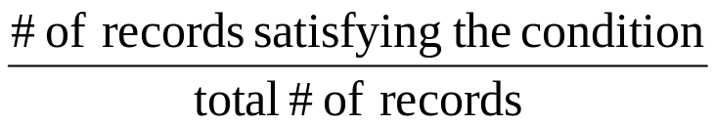

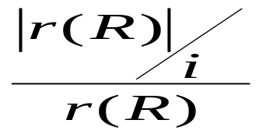

COND1 AND COND2 AND …AND CONDN
More than one of attributes involved in conditions that have access path
Choose the access path
Retrieve the fewest records
In the most efficient way
selectivity=
estimates of selectivities =
(1) key attribute
(2) nonkey attribute
where i : # of listing values for attribute in r(n)
16-6
18-<number>

Slide 16
(OP 4’) Disjunctive Condition
σ_{DNO=5 OR SALARY>30000 OR SEX=F} (EMPLOYEE)
Union the records that satisfy the individual conditions
(union record pointers)
16-7
18-<number>

Slide 17
Implementing Join
Theta Join
‧ Equi Join
‧ Natural Join
‧ Two-way Join
Multiway Join
R A=BS
(OP 6) EMPLOYEE _{DNO=DNUMBER} DEPARTMENT
(OP 7) DEPARTMENT _{MGRSSN=SSN} EMPLOYEE
J1 Nested (inner-outer) loop (brute force)
For t ∈ r[R]
retrieve ∀s from S
test t[A] = s[B]
16-8
18-<number>

Slide 18
Implementing Join (Cont.)
J2 Use access structure to retrieve matching record(s)
an index exists for one of two join attributes.
(B of S)
Retrieve ∀ t ∈ r(R)
Use access structure to retrieve matching records s from S such that s[B] = t[A]
Single
loop
16-8
18-<number>

Slide 19
Implementing Join (Cont.)
J3 Sort-Merge Join
Records of R and S are physically sorted (ordered) by A and B. ( see 16-10a)
16-9
18-<number>

Slide 20
Implementing Join (Cont.)
J4 Hash-Join
Records of R and S are both hashed to the same hash file, using the same hashing function on A and B.
A single pass through the file with few records hashes its records to the hash file buchet.
A single pass through the other file then hashes each of its records to the appropriate buchet, where the record is combined with all matching records from R.
partitioning
phase
probing
phase
16-9
18-<number>

Slide 21
Buffer Space on Join Performance
(OP 6) EMPLOYEE ⋈ _{DNO = DNUMBER} DEPARTMENT
( J1 ) nested-loop approach
n_{B} = 7 blocks (buffers)
DEPARTMENT
r_{D} =50 records b_{D} = 10 disk blocks
EMPLOYEE
r_{E} =5000 records b_{E} = 2000 disk blocks
Outer loop file: n_{B－2} blocks
Inner loop file: 1 block
Result file: 1 block
18-9-1
18-<number>

Slide 22
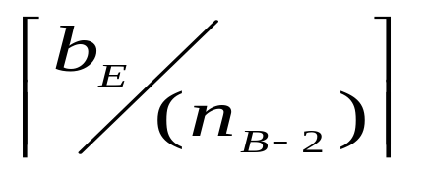
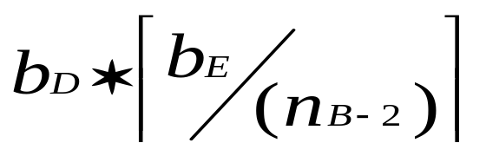
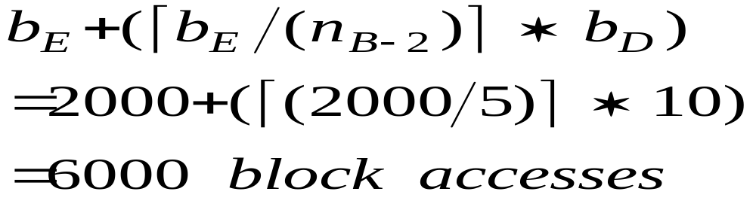
Buffer Space on Join Performance (Cont.)
EMPLOYEE used for outer loop
of blocks accessed for outer file: b_{E}
of times (n_{B－2}) blocks of outer file are
loaded :
of blocks accessed for inner file:
18-19-1/2
18-<number>

Slide 23
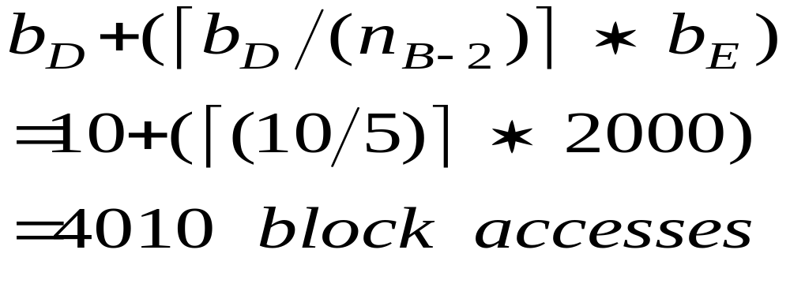
Buffer Space on Join Performance (Cont.)
DEPARTMENT used for outer loop
bRES: result file of join operation
18-9-2
18-<number>

Slide 24
Join Selection Factor on join performance
The percentage of records in a file will be joined with
records in the other file
(OP7) DEPARTMENT ⋈_{MGRSSN=SSN} EMPLOYEE
Assume secondary indexes exist on SSN of EMPLOYEE and MGRSSN of DEPARTMENT
X_{SSN} = 4 X_{MGRSSN}=2
50 records
5000 records
4950 will not be joined
18-9-3
18-<number>

Slide 25
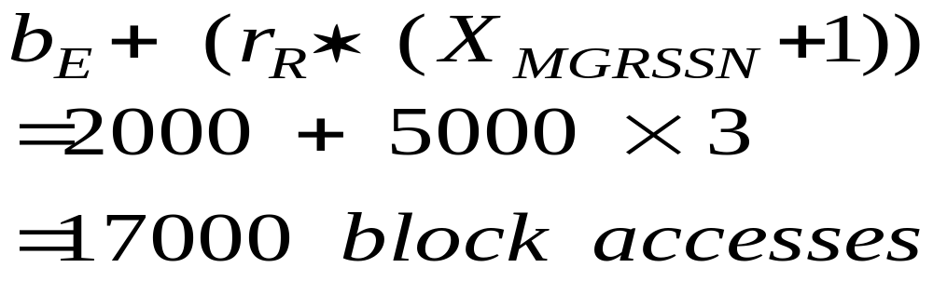
Join Selection Factor on join performance (Cont.)
Retrieve each EMPLOYEE record and then use the index on MGRSSN of DEPARTMENT
18-9-3
18-<number>

Slide 26
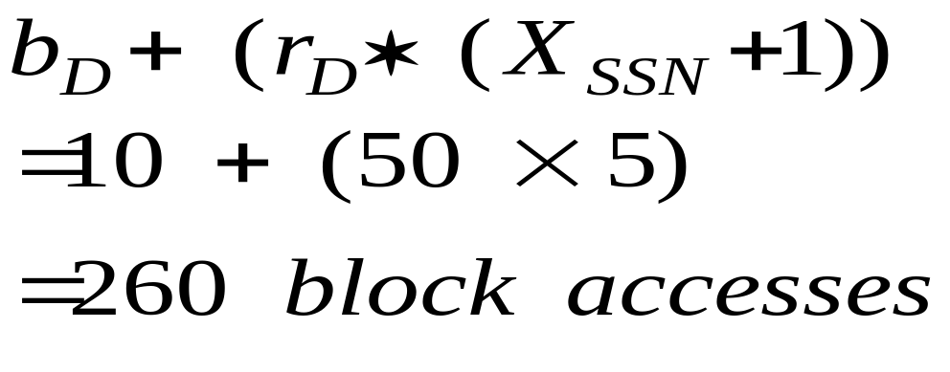
Join Selection Factor on join performance (Cont.)
Retrieve each DEPARTMENT record and then uses the index on SSN of EMPLOYEE
Sort merge join J3
b_{E} + b_{D} + b_{E} log₂ b_{E} + b_{D} log₂ b_{D}
Smaller file
The file that has
a match for
every record
merge
sort
18-9-4
18-<number>

Slide 27
Partition Hash Join
Partitioning phase: two iterations
R ⋈ _{A=B} S
M: minimum number of in-memory buffers
R is partitioned into R₁,R₂,…,R_{M}
S is partitioned into S₁,S₂,…,S_{M}
by using the same hash function
whenever the in-memory buffer for a partition gets filed, its contents are appended to a disk subfile
2＊( bR+bS)
(read+write)
18-9-5
18-<number>

Slide 28
Partition Hash Join (Cont.)
Joining or probing phase: M iterations
During iteration i, the two partitions R_{i} and S_{i} are joined.
b_{R} + b_{S} : read
3 × ( b_{R} + b_{S} ) + b_{RES}
18-9-5
18-<number>

Slide 29
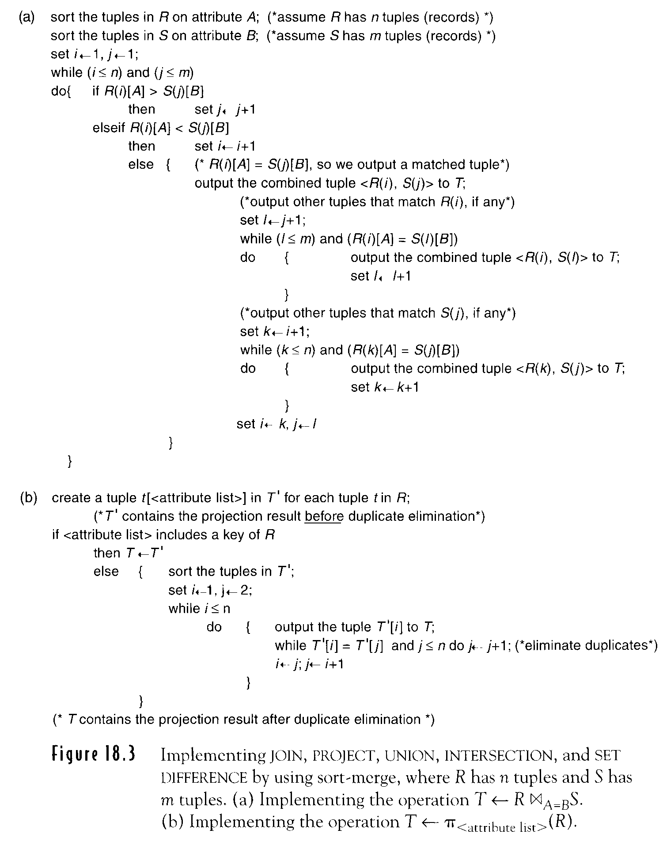
Figure 18.3(a) T← R ⋈ A=B S
Sort-merge
16-10
18-<number>

Slide 30
Figure 18.3(b) T← Π <attribute list> (R)
Alternative
hashing
16-10
18-<number>

Slide 31
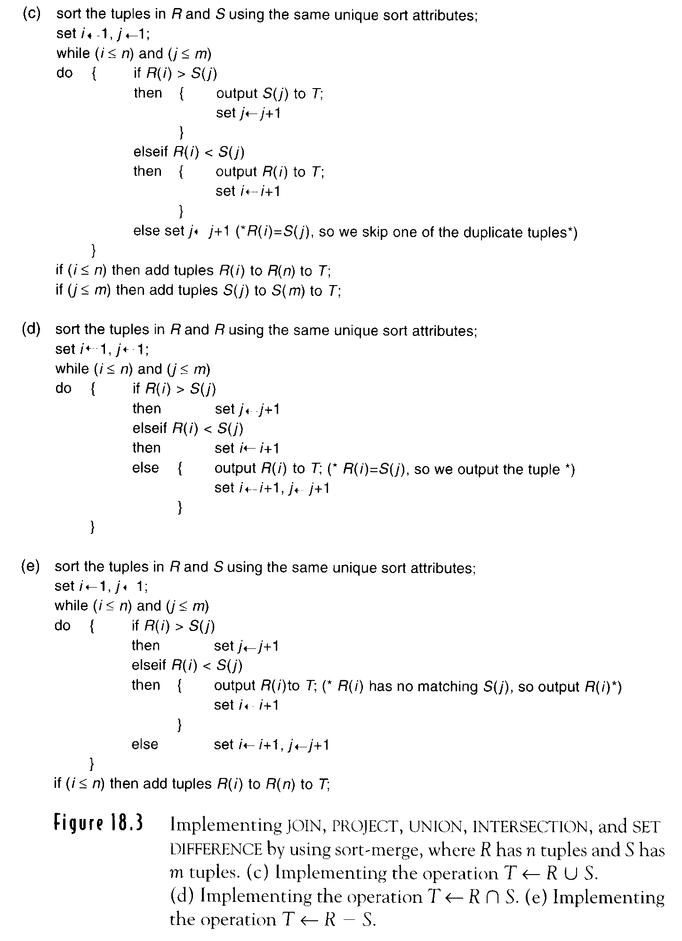
Figure 18.3(c) T← R∪S
16-11
18-<number>

Slide 32
Figure 18.3(d) T← R∩S
16-11
18-<number>

Slide 33
Figure 18.3(e) T← R－S
16-11
18-<number>

Slide 34
Implementing PROJECT
Π_{<attribute list>} (R) = R’
Key ∈ <attribute list>
|R|=|R’|
Key ∉ <attribute list>
|R|= |R’|
Eliminate duplicate tuples
see Figure 18.3b (18-30)
16-12
18-<number>

Slide 35
Implementing Set Operation
UNION (see 18-31 Figure 18.3c)
INTERSECTION (see 18-32 Figure18.3d)
SET DIFFERENCE (see 18-33 Figure 18.3e)
CARTESIAN PRODECT (modification)
Sort the two relations on the same
attributes hashing
Alternative
16-12
18-<number>

Slide 36
Implementing aggregate functions
MAX, MIN
SELECT MAX (SALARY)
FROM EMPLOYEE
an (ascending) index on SALARY
MAX: rightmost position in each index node from
the root to the rightmost leaf
MIN: leftmost position is followed from the root to
the leftmost leaf.
18-12-1
18-<number>

Slide 37
Implementing aggregate functions (Cont.)
COUNT, AVERAGE, SUM
dense index: there is an index entry for every record in the main file
SELECT DNO, AVG (SALARY)
FROM EMPLOYEE
GROUP BY- Sorting or hashing, clustering index
18-12-1
18-<number>

Slide 38
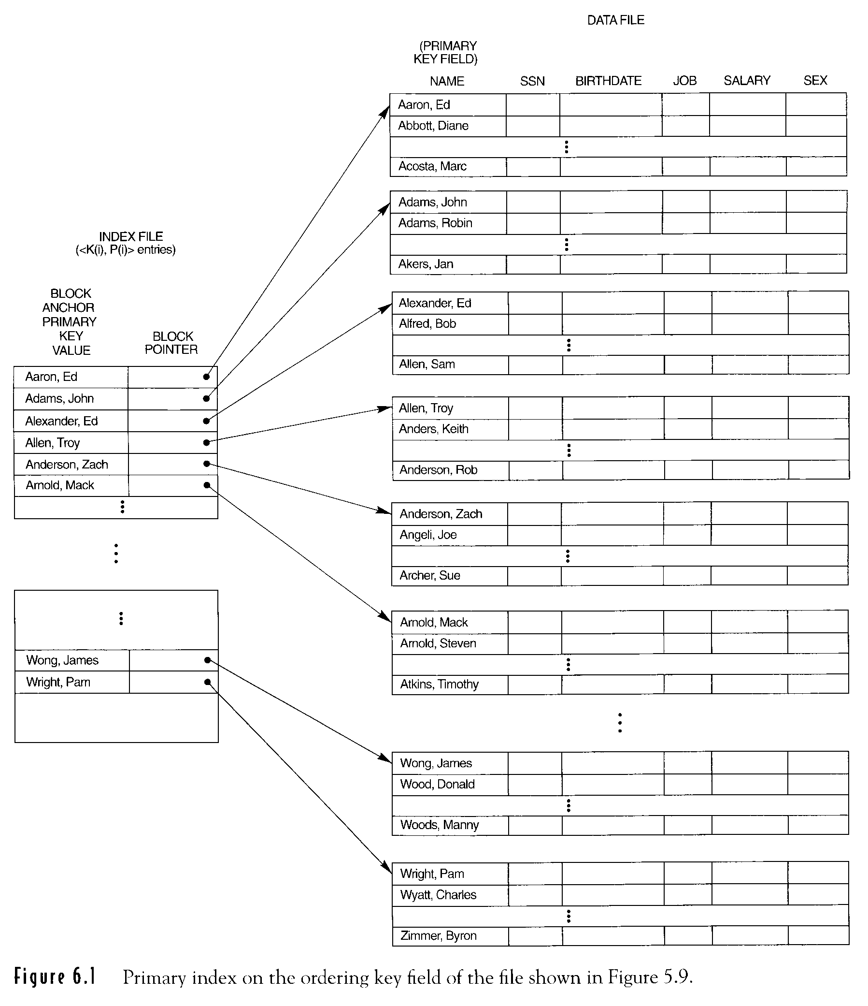
Figure 6.1
nondense index
18-12-2
18-<number>

Slide 39
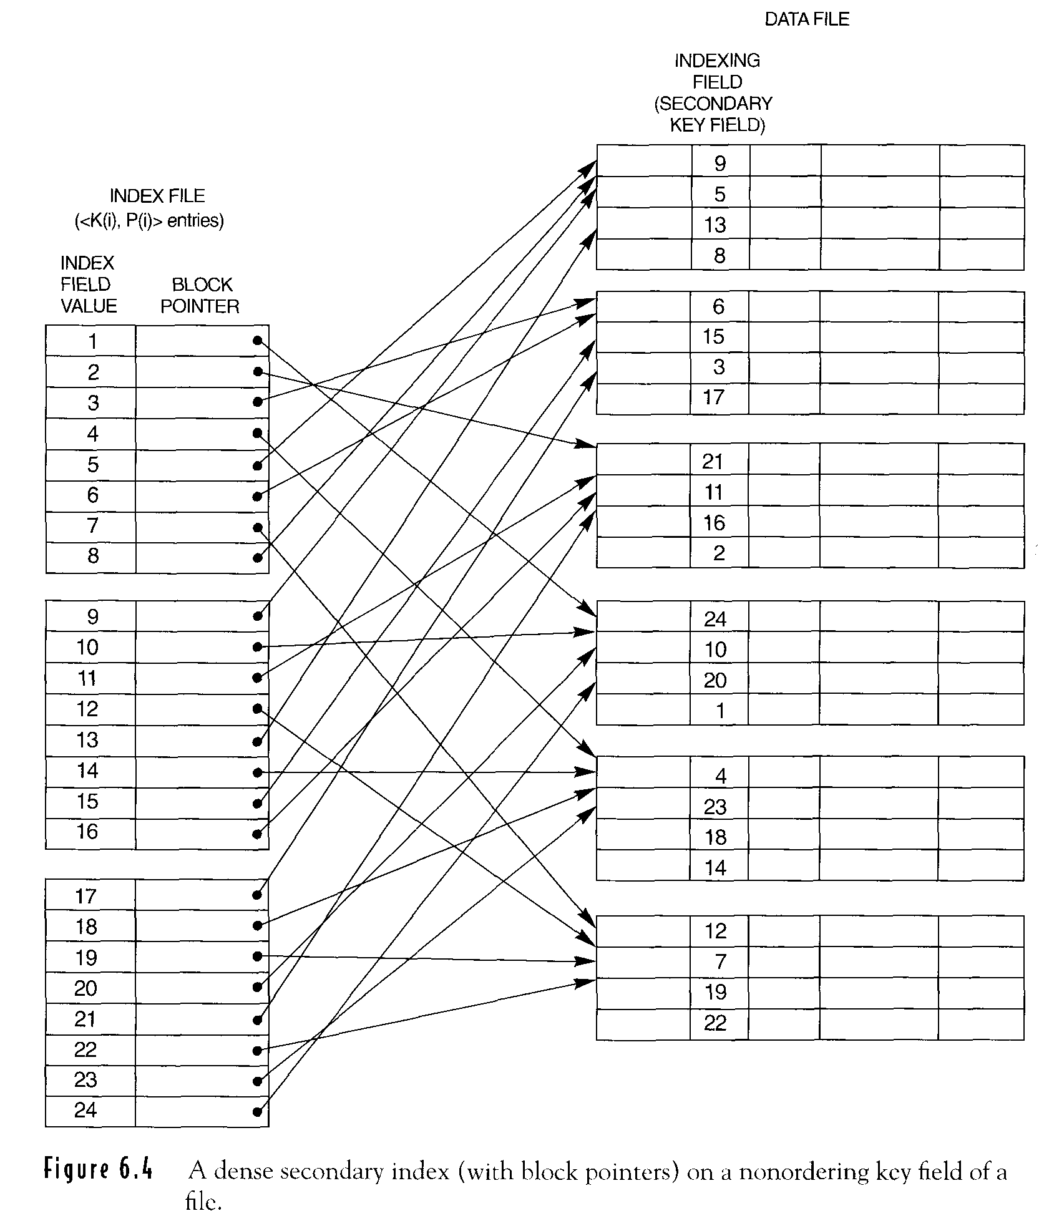
Figure 6.4
dense index
18-12-3
18-<number>

Slide 40
Outer Join
left outer join
right outer join
full outer join
SELECT LNAME, FNAME, DNAME
FROM ( EMPLOYEE LEFT OUTER JOIN
DEPARTMENT ON DNO = DNUMBER );
18-12-4
18-<number>

Slide 41
Modification of join algorithms use nested-loop join to compute left-outer join
Left relation as the outer loop
If there are matching tuples in the other relation, the joined tuples are produced and saved in the result.
If no matching tuples are found, the tuple is included by padding with null values.
18-12-4
18-<number>

Slide 42

Combining Operation for Query Execution
Reduce the number of temporary files
Using Heuristics in Query Optimization
Apply SELECT and PROJECT before applying JOIN or other binary operations.
Query Tree Notation
(Relational Algebra Expression)
Query Graph Notation
(Relational Calculus Expressional)
16-13
18-<number>

Slide 43
Heuristic Optimization of Query Trees
Query Tree (relational algebra expression)
leaf node :relations
Internal node :relational algebra operations
execution of query trees: post order traversal of tree
6-14
18-<number>

Slide 44
Example Q2
For each project located in ‘stafford’ retrieve the project number, the controlling department number, and the department manager’s name.
ΠPNUMBER, DNUM, LNAME, AADDRESS, BDATE
(((σ_{PLOCATION=‘Stafford’} (PROJECT))
⋈ _{DNUM=DNUMBER} (DEPARTMENT))
⋈ _{MGRSSN=SSN} (EMPLOYEE)) ≡
SELECT PNUMBER, DNUM, LNAME, ADDRESS, BDATE
FROM PROJECT, DEPARTMENT, EMPLOYEE
WHERE DNUM=DNUMBER AND
MGRSSN=SSN AND
PLOCATION=‘Stafford’
6-14
18-<number>

Slide 45
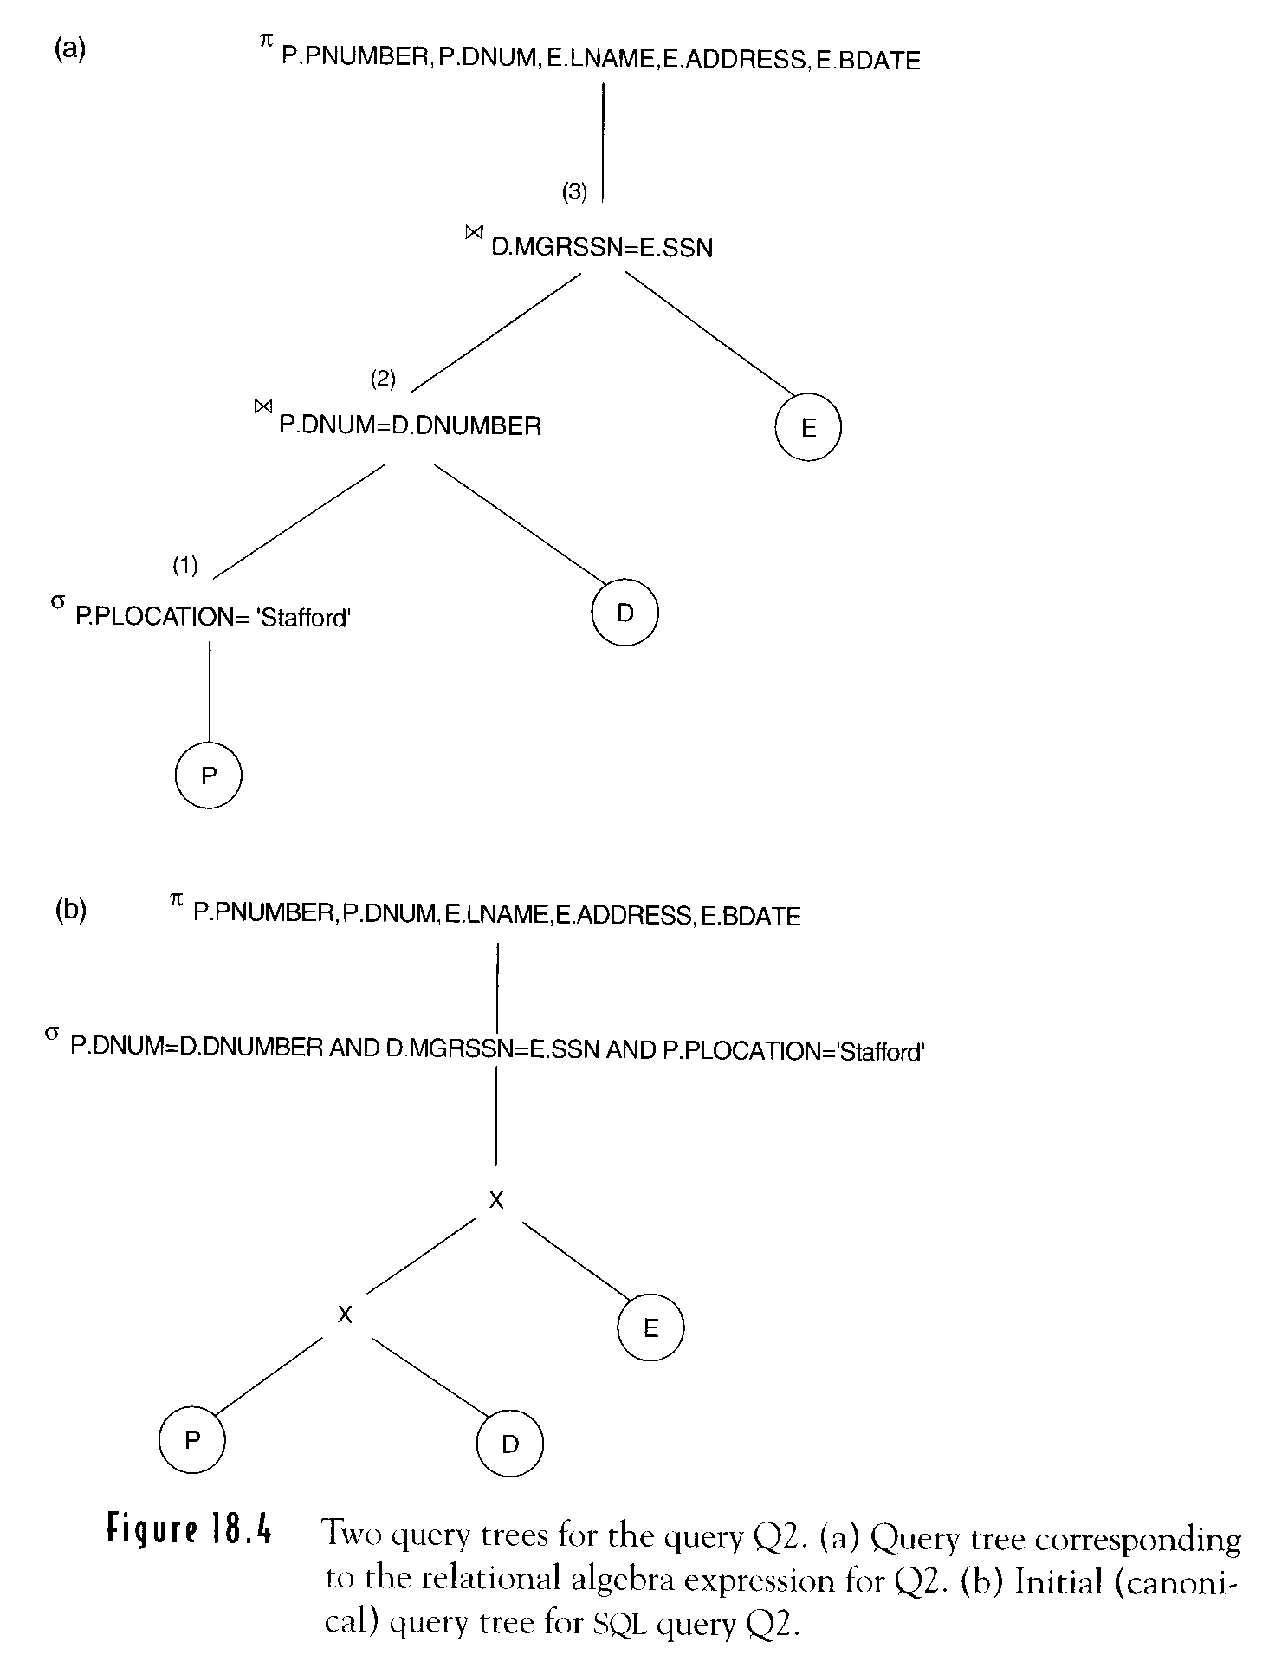
Figure 18.4
Query tree corresponding to relational algebra expression Q2
6-15
18-<number>

Slide 46
SELECT (a)
FROM (b)
WHERE (c)
Canonica query tree for
(a)
(b)
(b)
PROJECT DEPARTMENT EMPLOYEE
Sizes 100 50 150
tuples 100 20 5000
CARTESIAN PRODOCT, 100 × 20 × 5000 = 10 millions 300bytes

Slide 47
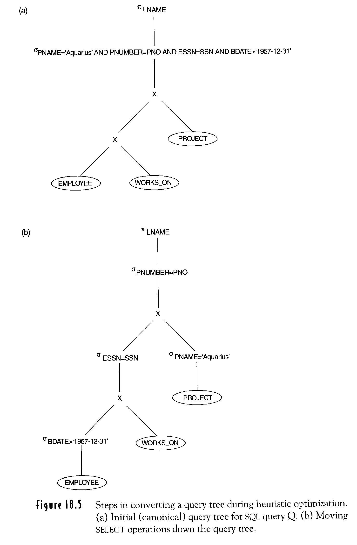
SELECT LNAME
FROM EMPLOYEE, WORKS_ON, PROJECT
WHERE PNAME=“Aquarius’ AND PNUMBER=PNO
AND ESSN=SSN AND BDATE > ‘DEC-31-1957’
Canonical query tree
6-16
18-<number>

Slide 48
Moving SELECT operations
down the query tree
6-16
18-<number>

Slide 49
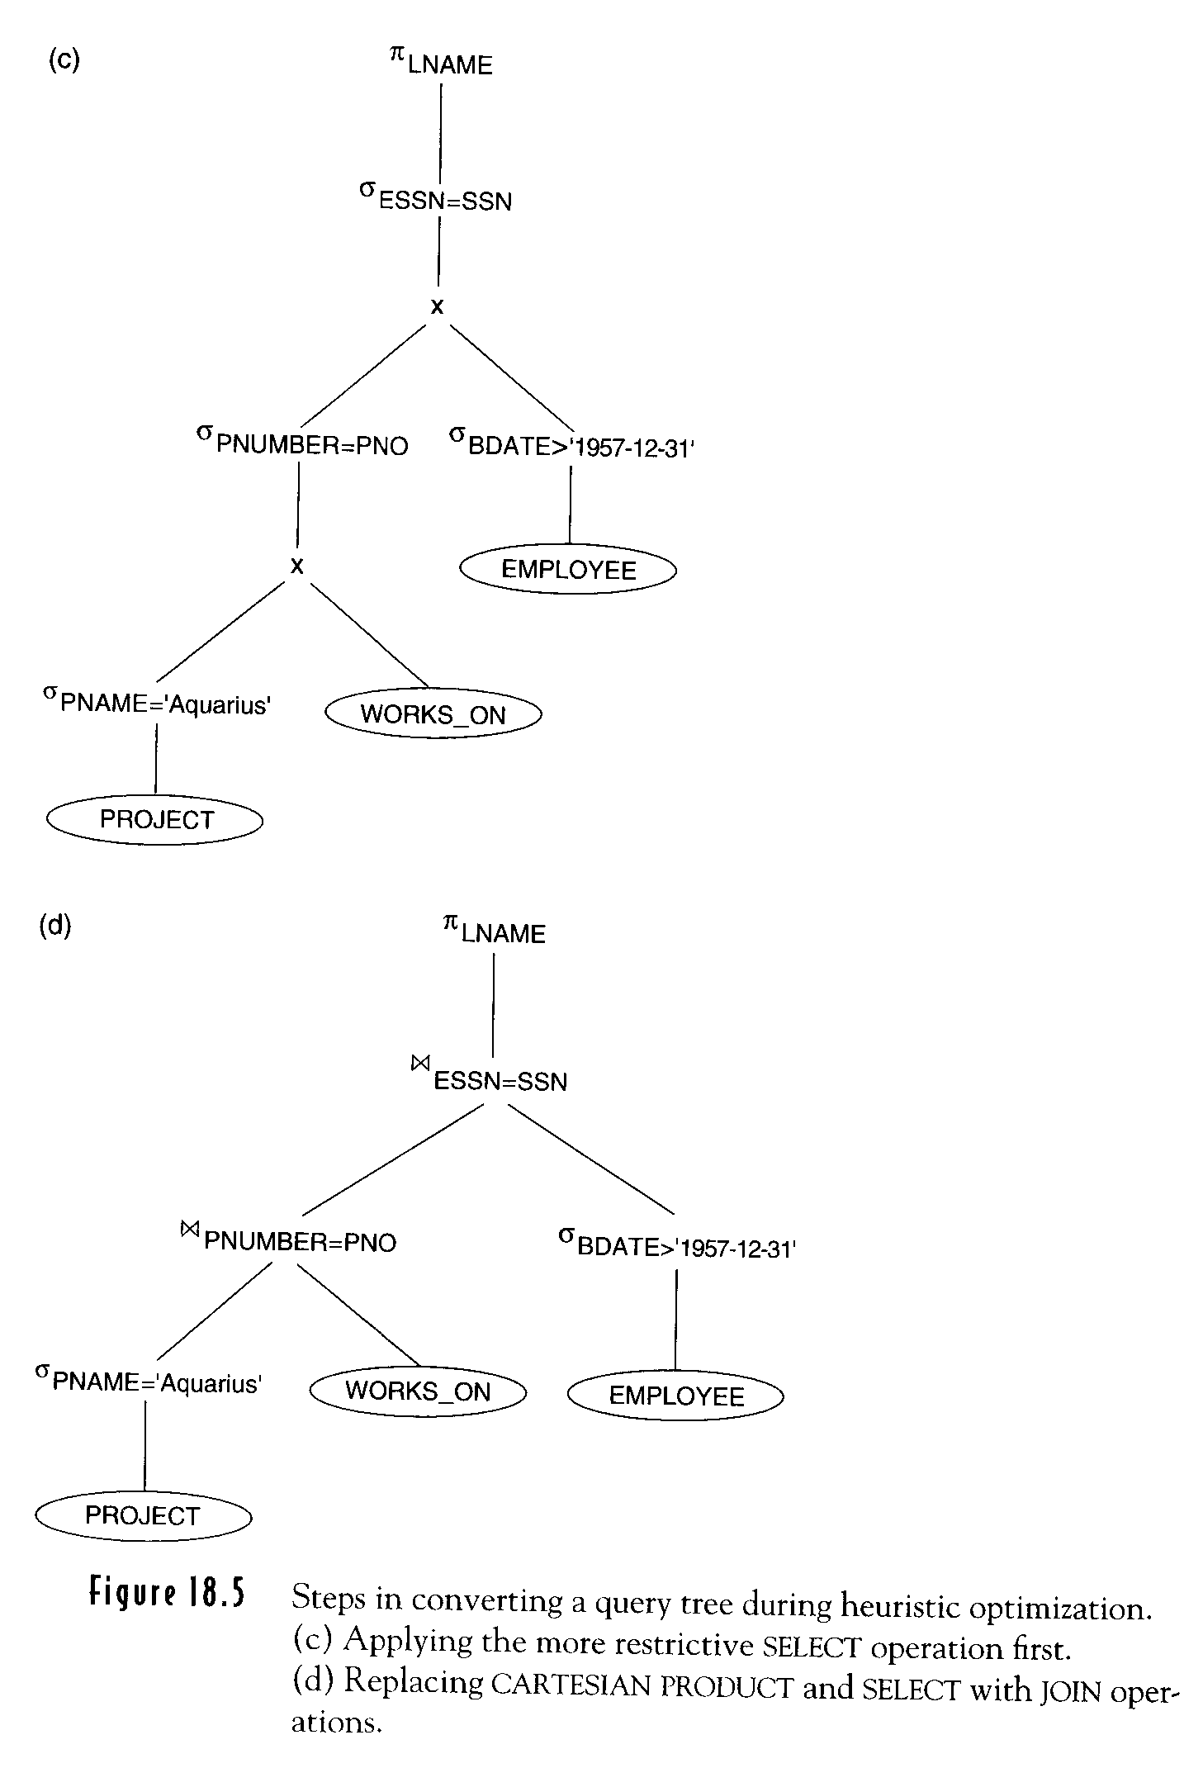
Figure 18.5(c) Applying more
restrictive SELECT operation first
SELECT LNAME
FROM EMPOYEE, WORKS_ON, PROJECT
WHERE PNAME=‘Aquarius’ AND
PUMBER=PNO AND
ESSN=SSN AND
BDATE > ‘DEC-31-1957’
6-17
18-<number>

Slide 50
Replacing CARTESIAN PRODUCT and SELECT with JOIN
6-17
18-<number>

Slide 51
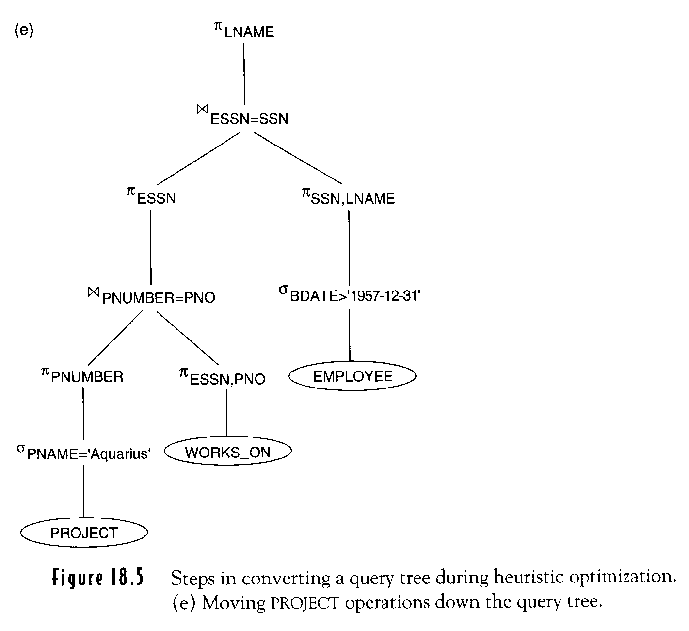
Moving PROJECT operations down
Transformation should keep equivalence
6-18
18-<number>

Slide 52
General Transformation Rules for Relational Algebra Operations
Cascade of σ
σ_{C1 AND C2 AND …AND Cn}(R)≡σ_{C1}(σ_{C2}(…(σ_{Cn}(R))…)
Commutativity of σ
σ _{C1} (σ _{C2} (R)) ≡ σ _{C2} (σ _{C1} (R))
Cascade of Π
Π_{list1}(Π_{list2} …(Π_{listn}(R))…) ≡ Π_{list1}(R)
Commuting σwith Π
Π_{A1, A2,…,An} (σ _{C} (R))≡ σ _{C} (Π_{A1, A2,…,An} (R))
C involves only A1,…,An
6-19
18-<number>

Slide 53
General Transformation Rules for Relational Algebra Operations (Cont.)
Commutativity of ⋈ ( or × )
R ⋈ _{C} S ≡ S ⋈ _{C} R
meaning
Commuting σwith ⋈ ( or × )
σ_{C} (R ⋈ S) ≡(σ_{C} (R) ) ⋈ S
attributes in C involve only attributes of R
σ_{C} (R ⋈ S) ≡(σ_{C1} (R) ) ⋈ (σ_{C2} (S) )
C1 (C2) involves only attribute of R(S)
16-20
18-<number>

Slide 54
General Transformation Rules for Relational Algebra Operations (Cont.)
Commuting Π with ⋈ ( or × )
Π_{L}( R ⋈ _{C} S)≡(Π_{A1,…,An} (R)) ⋈ _{C} (Π_{B1,…,Bm} (S))
L = { A1,…, An, B1,…, Bm }
join condition C only involves L
General Form
Π_{L} ( R ⋈ _{C} S) ≡
Π_{L} ((Π_{A1,…,An, An+1,…,An+k} (R)) ⋈
(Π_{B1,…,Bm, Bm+1,…,Bm+p}(S))
16-20
18-<number>

Slide 55
General Transformation Rules for Relational Algebra Operations (Cont.)
Commutativity of set operations
∪ and ∩
Associativity of ⋈, Ⅹ, ∪, ∩
(R  S) ^{T} ≡ R  ( S  T )
Commuting σwith set operations
σ_{C} ( R  S) ≡ (σ_{C} ( R ))  (σ_{C} ( S ))
 : ∪, ∩, －
16-21
18-<number>

Slide 56
General Transformation Rules for Relational Algebra Operations (Cont.)
Πoperation commutes with ∪
Π_{L} (R ∪S) = (Π_{L} (R) ) ∪(Π_{S} (B) )
(σ_{C} (R × S) ) = ( R ⋈ _{C} S )
Other Transformations
C ≡ NOT ( C₁ AND C₂ )
≡ ( NOT C₂ ) OR ( NOT C₂ )
NOT ( C₁ OR C₂ )
≡ ( NOT C₁ ) AND ( NOT C₂ )
16-21
18-<number>

Slide 57
Outline of a Heuristic Algebra Optimization Algorithm
Break up any SELECT operations with conjunctive conditions into a cascade of SELECT operations.
σ_{C1 AND C2 AND …AND Cn}(R)≡σ_{C1} (σ_{C2} (…(σ_{Cn}(R))…))
Move each SELECT operations as far down the query tree as is permitted by the attributes
σ_{C1}(σ_{C2}(R)) ≡ σ_{C2}(σ_{C1}(R))
Π_{A1,A2…,An} (σ_{C} (R)) ≡ σ_{C} (Π_{A1,A2…,An} (R))
σ_{C} (R ⋈ S) ≡ (σ_{C} (R)) ⋈ S
σ_{C} (R  S) ≡ (σ_{C} (R))  (σ_{C} (S))
16-21
18-<number>

Slide 58
Outline of a Heuristic Algebra Optimization Algorithm (Cont.)
Rearrange the leaf nodes of tree so that the leaf node relations with the most restrictive operations are executed first.
(R  S) T ≡ R (ST)
Combine CARTESIAN PRODUCT with a sub sequent SELECT into a Join.
fewest tuples or smallest
absolute size
16-21
18-<number>

Slide 59
Outline of a Heuristic Algebra Optimization Algorithm (Cont.)
Break down and move lists of projection attributes down the tree as far as possible.
ΠList1 (ΠList2 (…(ΠListn (R))…))= ΠList1 (R)
ΠA1,A2…,An (σC (R)) ≡ σC (ΠA1,A2…,An (R))
ΠL (R ⋈ C S) ≡ (ΠA1,…,An (R))⋈ (ΠB1,…,Bm(S))
ΠL (R  S) ≡ (ΠL (R)) (ΠL (S))
Identify subtrees that represent groups of operations that can be executed by a single algorithm.
Π(σC1 (R)) ⋈ C2 (Π(σC3 (R)) ) see 6-18
16-22
18-<number>

Slide 60
Heuristic Optimization of Query Graph
(Relational Calculus)
Query Decomposition Technique
Query Graph for QUEL language
Node: tuple variable
Constant node: constant values
Edges: join condition
selection condition
16-23
18-<number>

Slide 61
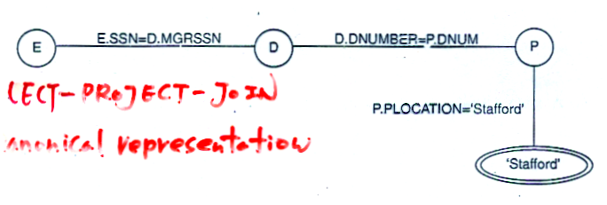
Q2: RANGE OF P IS PROJECT, D IS DEPARTMENT, E IS EMPLOYEE
RETRIVE (P.PNUMBER, D.DNUMBER, E.LNAME, E.BDATE,
E.ADDRESS)
WHERE P.DNUM=D.DNUMBER AND D.MGRSSN=E.SSN AND
P.PLOCATION=‘Stafford’
SELECT-PROJECT-JOIN
Canonical representation
What the query will retrieve but not how to execute the query

Slide 62
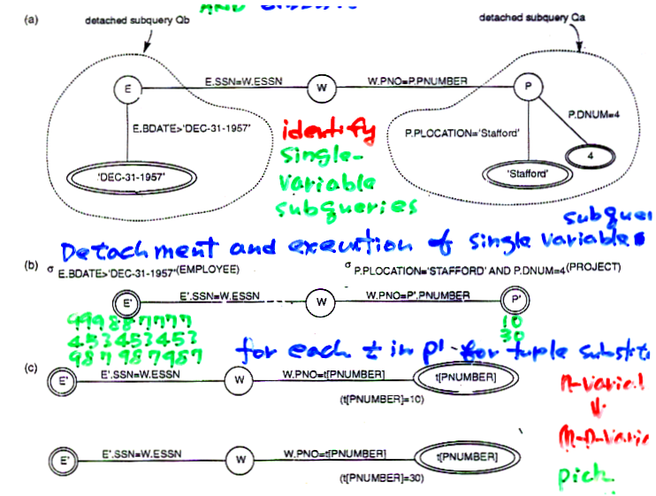
Detachment and Tuple Substitution
Q’: RANGE OF P IS PROJECT, W IS WORKS_ON, E IS EMPLOYEE
RETRIVE ( E.LNAME )
WHERE P.PLOCATION=‘Stafford’ AND P.DNUM=4 AND
P.PNUMBER=W.PNO AND W.ESSN=ESSN
AND E.BDATE > ‘DEC-31-1957’
Detached subquery Qa
Detached subquery Qb
Identify
single-variable
subqueries
Detachment and execution of single variable subqueries

Slide 63
(b) σE.BDATE > ‘DEC-31-1957’‘(EMPLOYEE)
σP.PLOCATION=‘STAFFORD’ AND P.DNUM=4 (PROJECT)
E’
E‘.SSN=W.ESSN
W
W.PNO=P’.PNUMBER
P’
999887777
453453453
987987987
10
30
For each t in P’ for tuple substitution n- variable
(n-1)- variable
pick small relation
E’
E‘.SSN=W.ESSN
W.PNO=t[PNUMBER]
t[PNUMBER]
W
(t[PNUMBER]=10)
E’
E‘.SSN=W.ESSN
W.PNO=t[PNUMBER]
t[PNUMBER]
W
(t[PNUMBER]=30)
16-25
18-<number>

Slide 64
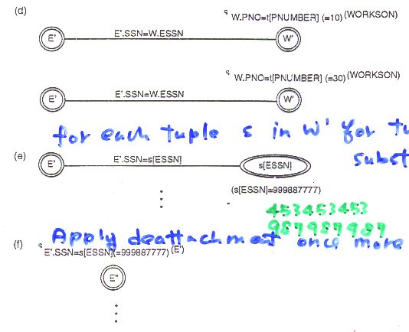
Apply deattachment once more.
For each tuple s in W’ for tuple substitution
Apple deattachment once more.
453453453
987987987

Slide 65
Using Cost Estimates in Query Optimization
compiled query
interpreted query
Cost Components for Query Execution
Access cost to secondary storage (large database)
Searching for, reading, writing data blocks.
Storage Cost
Storing intermediate files
Computation Cost (smaller database)
Searching for, sorting, merging, records, computing field values,…
16-27
18-<number>

Slide 66
Cost Components for Query Execution (Cont.)
Communication Cost (distributed database)
query (result) from query site
to database site,(database site)
(query)
Memory Usage Lost
number of memory buffers needed during query execution
16-27
18-<number>

Slide 67
Catalog Information used in Lost Functions
The size of each file
number of records (tuples) r
number of blocks b
blocking factor bfr
Primary access method (attributes)
number of levels × of each multilevel index
number of first-level index blocks b_{I1}
number of distinct values d of an indexing attributes
selection cardinality s of an attributes
key attribute s=1 sl=1/r
nonkey attribute s=(r/d) sl=1/d
(leave nodes)
16-28
18-<number>

Slide 68
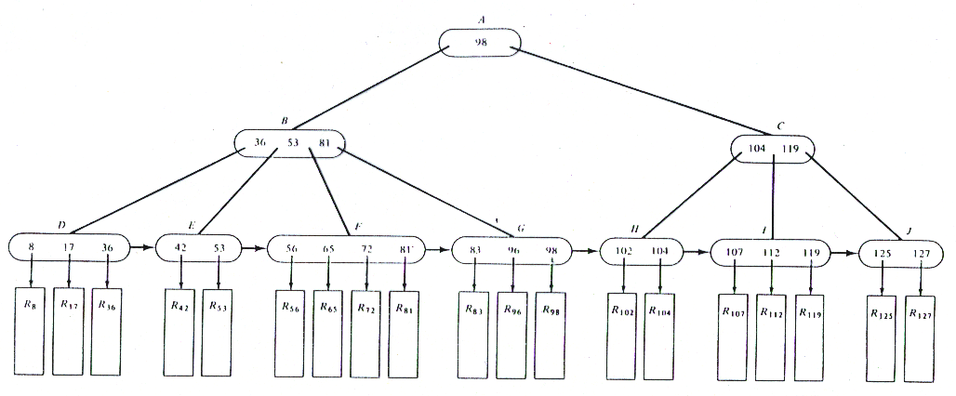
98
98 53 81
104 109
8 17 36
42 53
56 65 72 81
83 96 98
102 104
107 112 119
125 127
16-28.2
18-<number>

Slide 69
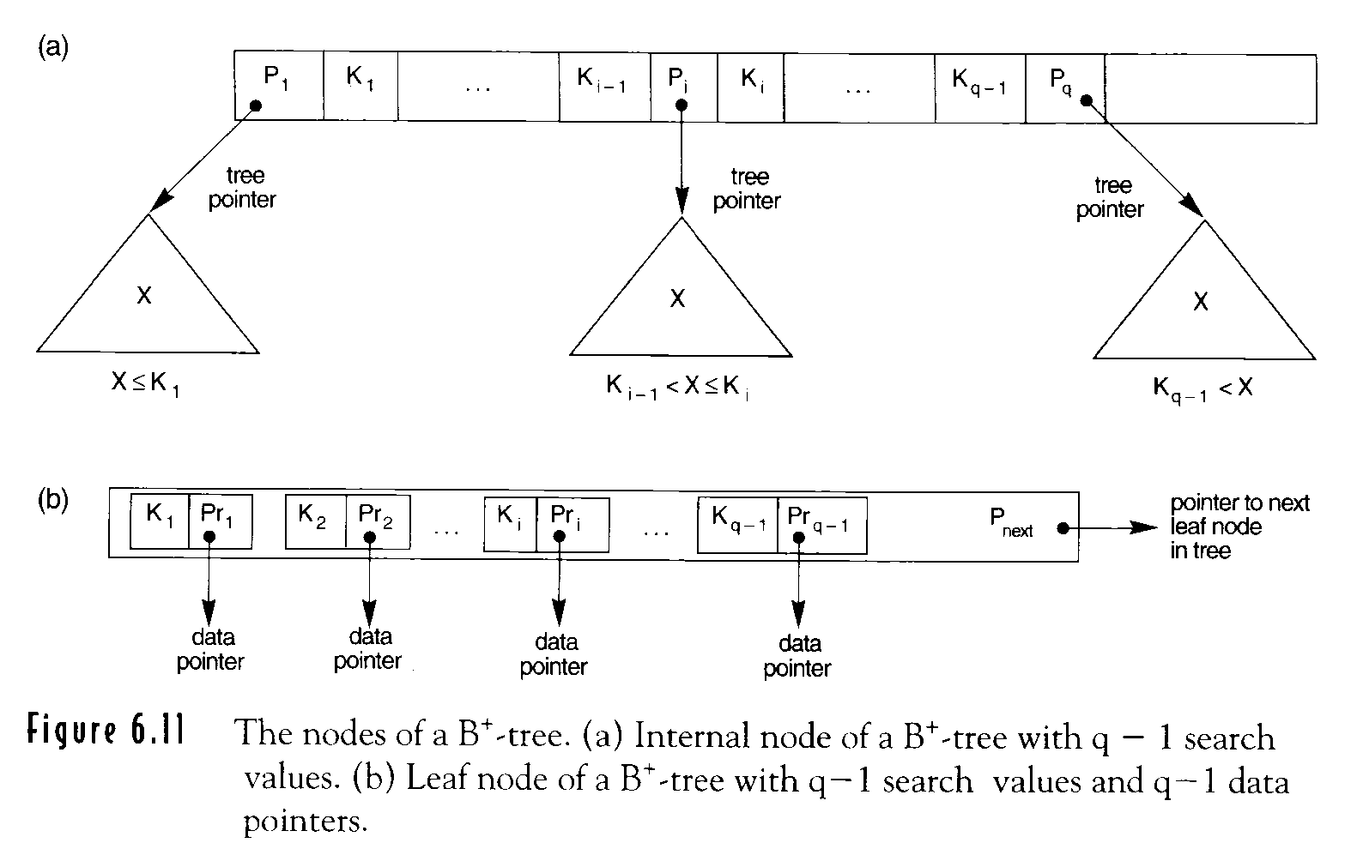
16-28.1
18-<number>

Slide 70
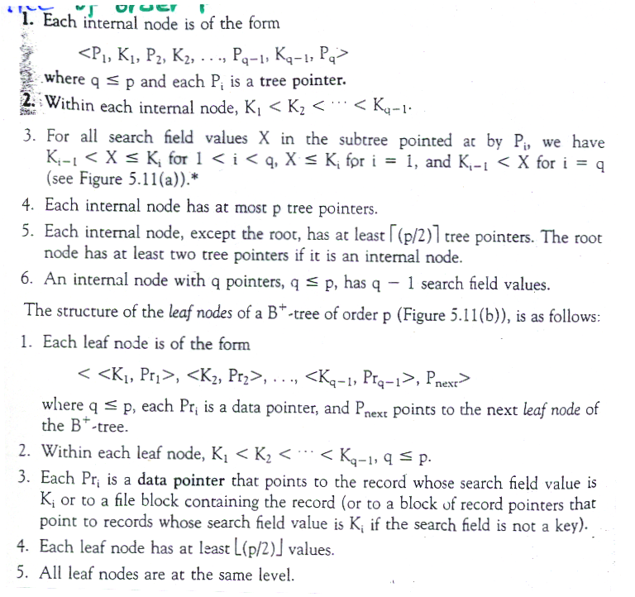
B⁺ tree of order P

Slide 72
Examples of Lost Functions for SELECT memory ← # of block transfer → disk
S1. Linear Search (Brute Force)
  all records satisfying the selection condition
  C_{S1a=b}
  equality condition on a key
  C_{S1b}=(b/2) 成功
  C_{S1b}= b 失敗
16-29
18-<number>

Slide 73
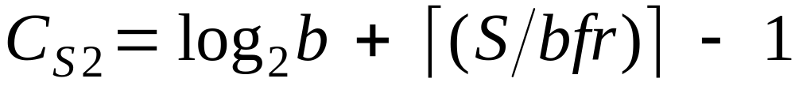
Examples of Lost Functions for SELECT (Cont.)
S2. Binary Search
special case: equality condition on equality
attribute S = 1
C_{S2} = log₂b
σ_{SSN=123456789}EMPLOYEE
locate
# of blocks satisfying the
selection condition
16-29
18-<number>

Slide 74
Examples of Lost Functions for SELECT (Cont.)
S3. Primary index
C_{S3a}= X+1
hashing σ_{SSN=123456789} (EMPLOYEE)
C_{S3b}= 1
C_{S3b}= 2
S4. Using an ordering index to retrieve multiple records.
σ_{DNUMBER > 5} (DEPARTMENT)
>, ≥, <, or ≤ on a key field with an ordering index:
C_{S4}= X+(b/2) rough estimation
locate
scan
16-30
18-<number>

Slide 75
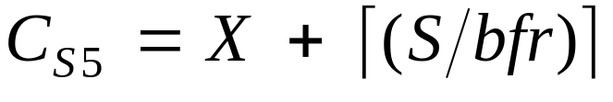
Examples of Lost Functions for SELECT (Cont.)
S5. Using a clustering index to retrieve multiple records
σ_{DNO = 5} (EMPLOYEE)
S6. Using a secondary (B⁺-tree) index
equality comparison
C_{S6a} = X + S
>, ≥, <, ≤ comparisons
C_{S6b} = X + (b_{I1}S / 2) + ( r / 2)
each record may reside on a different block
assume half the file records
satisfy the condition
16-30/31
18-<number>

Slide 76
Examples of Lost Functions for SELECT (Cont.)
S7. Conjunctive Selection
σDNO=5 AND SALARY>30000 AND SEX=F (EMPLOYEE)
S1 or one of S2-S6
S8. Conjunctive selection using a composite index
S3a, S5, S6a
σ_{ESSN=123456789 AND DNO=10}(WORKS_ON)
16-31
18-<number>

Slide 77
EMPLOYEE
FNAME, MINIT, NAME, SSN, BDATE, ADDRESS, SEX, SALARY, SUPERSSN, DNO
r_{E} =10,000 records,
b_{E} =2000 disk blocks
bfr_{E}= 5 records / block
Access paths:
1. Cluster index on SALARY XSALARY = 3, SSALARY = 20
2. Secondary index on SSN XSSN = 4, SSSN= 1
3. Seconding index on DNO
XDNO = 2 bI1DNO = 4
dDNO = 125
SDNO = (10,000 / 125) = 80
16-32
18-<number>

Slide 78
Access paths (Cont.):
4. Secondary index on SEX
XSEX=1, dSEX=2
SSEX = (10,000 / 2) = 5000
(OP1) σ_{SSN=123456789}(EMPLOYEE)
Ⅹ Brute force
C_{S1b}=( b_{E} / 2) =( 2000 / 2) = 1000
⃝ Secondary index
C_{S6a} = X_{SSN} + 1 = 4 + 1 =5
16-33
18-<number>

Slide 79
(OP2) σ_{DNO > 5} (EMPLOYEE)
⃝ Brute force
C_{S1a}= b_{E} = 2000
Ⅹ Secondary index
C_{S6b}= X_{DNO}+ ( b_{I1DO} / 2) + ( r_{E} / 2 )
= 2 + ( 4 / 2 ) + (10,000 / 2 )
= 5004
16-33
18-<number>

Slide 80
(OP3) σDNO =5 (EMPLOYEE)
Ⅹ Brute force
CS1a= bE = 2000
⃝ Secondary index
CS6a = XDNO+ SDNO
= 2 + 80
= 82s
16-34
18-<number>

Slide 81
(OP4) σDNO =5 AND SALARY > 30000 AND SEX=F (EMPLOYEE)
Ⅹ Brute force
CS1a= bE = 2000
⃝ Condition DNO=5
CS6a = XDNO+ SDNO = 2 + 80 = 82
Ⅹ Condition SALARY > 30000
CS4= XDNO+ ( bE / 2) = 3 + 2000 /2=1003
Ⅹ Condition SEX=F
CS6a = XSEX+ SSEX= 1+ 5000 = 5001
16-34
18-<number>

Slide 82

Examples of Lost Functions for JOIN
Estimate the size after join operation
Join selectivity js = |(R ⋈ _{C} S)| / |(R × S)|
= |(R ⋈ _{C} S)| / (|R| × |S|)
No join condition C
js = 1
No tuples satisfy join condition
js = 0
In general
0 ≤ js≤ 1
C: R.A = S.B
.. A is a key of R
|(R ⋈ _{C} S)| ≤ |S|
js ≤1/ |R|
.. B is a key of S
js ≤1/ |S|
16-35
18-<number>

Slide 83
The size of file after join operation
|(R ⋈ _{C} S)| = js ∗ |R| ∗ |S|
J1. Nested loop approach
R ⋈ _{A=B} S
R: b_{R} blocks R: outer loop
S: b_{S} blocks
three memory buffers
C_{J1}=b_{R}+ (b_{R} ∗ b_{S}) + ( ( js ∗ |R| ∗ |S|) / bfr_{RS} )
Write file in the disk
16-36
18-<number>

Slide 84
Single-loop join
J2. Use an access structure to retrieve the matching
records
index on join attribute B of S
  secondary index
  C_{J2a}= b_{R}+ (|R| ∗ ( X_{B}+ S_{B})) + …
  clustering index
  C_{J2b}= b_{R}+ (|R| ∗ ( X_{B}+ (S_{B} / bfr_{b}))) + …
  primary index
  C_{J2C}= b_{R}+ (|R| ∗ ( X_{B}+ 1 )) + …
  hash key
  C_{J2d}= b_{R}+ (|R| ∗ h ) + …
average # of block access
to a record
16-36/37
18-<number>

Slide 85
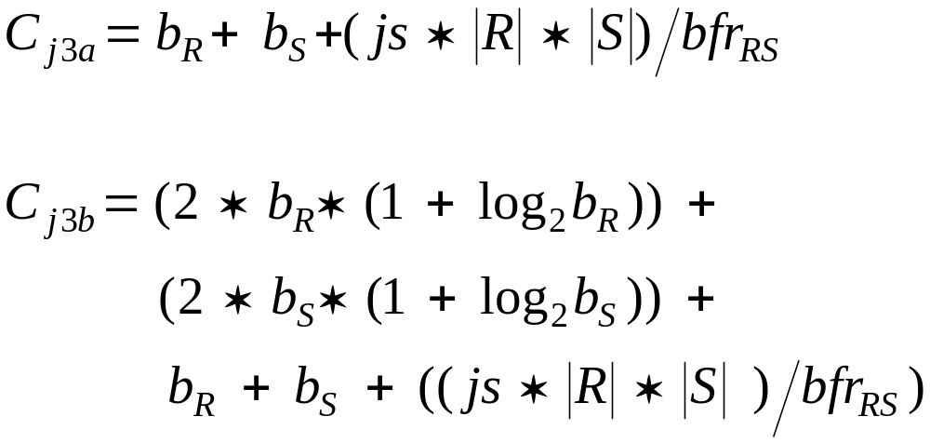
J3. Sort-Merge join (sorted on join attributes)
sort
merge
16-37
18-<number>

Slide 86
Example of Using the Lost Functions
EMPLOYEE file
  r_{E}=10,000 b_{E}=2000 bfr_{E}=5
  Clustering index on SALARY
  X_{SALARY}=3, S_{SALARY} =20
  Secondary index on SSN
  X_{SSN}= 4, S_{SSN}=1
  Secondary index on DNO
  X_{DNO}=2, b_{I1DNO}=4, d_{DNO}=125, S_{DNO}=80
  Secondary index on SEX
  X_{SEX}=1, d_{SEX}=2, S_{SEX}=5000
16-38
18-<number>

Slide 87
Example of Using the Lost Functions (Cont.)
DEPARTMENT file
  r_{D}=125, b_{D}=13
  Primary index on DNUMBER
  X_{DNUMBER}= 1
  Secondary index on MGRSSN
  S_{MGRSSN}= 1, X_{MGRSSN}=2
  Blocking factor for resulting file
  bfr_{ED}=4
16-38
18-<number>

Slide 88
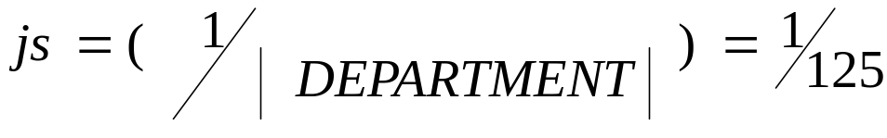
(OP6) EMPLOYEE ⋈ _{DNO=DNUMBER} DEPARTMENT
Ⅹ 1. Using J1 with EMPLOYEE as outer loop
CJ1 = bE + (bE ∗ bD) +( jsOP6 ∗ rE ∗ rD) / bfrED
= 2000 + 2000 ∗13 + 1/125 ∗10000 ∗ 125/4
= 30500
Ⅹ 2. Using J1 with DEPARTMENT as outer loop
CJ1a = bE + (bE ∗ bD) +…
= 13 + (13 ∗ 2000) +…
=28513
16-39
18-<number>

Slide 89
(OP6) EMPLOYEE ⋈ DNO=DNUMBER DEPARTMENT (Cont.)
Ⅹ 3. Using J2 with EMPLOYEE as outer loop
CJ2 = bE + (rE ∗ ( XDNUMBER +1)) +…
= 2000 + (10000 ∗ 2) +…
= 24500
⃝ 4. Using J2 with DEPARTMENT as outer loop
CJ2a = bD + ( rD∗ ( XDNO + SDNO) ) +…
= 13 + 125 ∗ ( 2 + 80 ) +…
= 12763
16-39
18-<number>

Slide 90
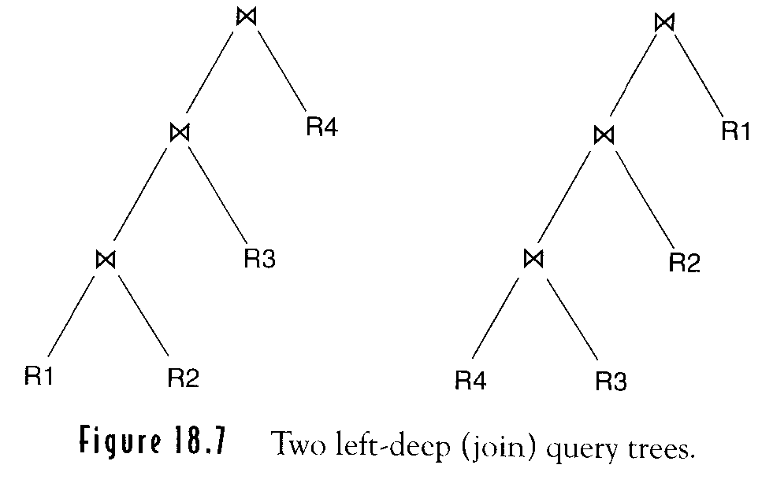
Multiple Relation Queries and Join Ordering
join n relations ⇒ n－1 join operations
left-deep tree: the right child of each nonleaf node is
always a base relation
18-39-1
18-<number>

Slide 91
Multiple Relation Queries and Join Ordering (Cont.)
Amenable to pipelining
example. Join algorithm: single-loop method
a disk page of tuples of the outer relation is used to probe the inner relation for matching tuples
Allow the optimizer to utilize any access paths on the inner relation
13-39-1
18-<number>

Slide 92
Example to Illustrate Cost-Based Query Optimization
Q2: SELECT PNUMBER, DNUM, LNAME, ADDRESS, BDATE
FROM PROJECT, DEPARTMENT, EMPLOYEE
WHERE DNUM=DNUMBER AND
MGRSSN=SSN AND
PLOCATION=‘Stafford’;
Potential join orders
PROJECT ⋈ DEPARTMENT ⋈ EMPLOYEE
DEPARTMENT ⋈ PROJECT ⋈ EMPLOYEE
DEPARTMENT ⋈ EMPLOYEE ⋈ PROJECT
EMPLOYEE ⋈ DEPARTMENT ⋈ PROJECT
18-39-2
18-<number>

Slide 93
13-39-2
18-<number>

Slide 94
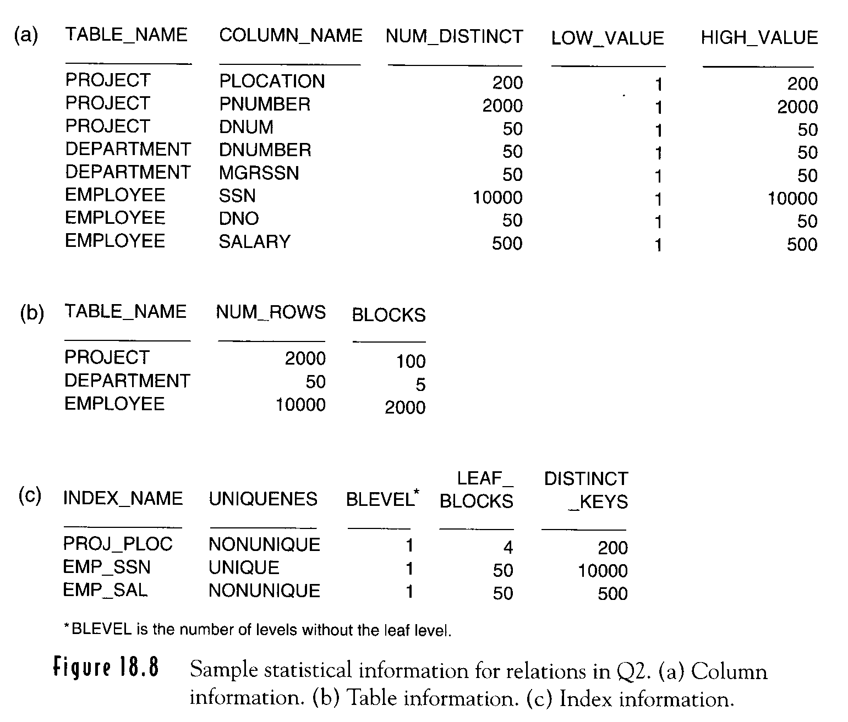
18-39-3
18-<number>

Slide 95
(1) PROJECT ⋈ DEPARTMENT ⋈ EMPLOYEE
PROJECT ⋈ DEPARTMENT
σ_{P.PLOCATION=‘Stafford’}
Join method : table scan
access method: no index
table scan (linear search)
PROJ_PLOC index
Selection method
18-39-4
18-<number>

Slide 96
SELECTION part
  Index access
  PROJ_PLOC: nonunique, level:2,
  leaf-block:4, distinct.keys:200
  PROJECT: PNUMBER: 2000
  lost = 2+10 =12 blocks accesses
  Table scan
  PROJECT: 100 blocks
  lost : 100 block accesses
(c)
(a)
data block
2000/200=10
index block
18-39-4
18-<number>

Slide 97
JOIN part
nested-loop join method
σP.PLOCATION = ‘Stafford’ = TEMP 1
PROJECT 2000 rows, 100 blocks
2000/100 = 20 tuples / block
(註: 由 (i) 選到 10 tuples)
(b)
10 tuples
TEMP1 ⋈DNUM=DNUMBER DEPARTMENT: temp 2
key
Assume blocking factor : 5
+ 100 blocks required
19-39-4/5
18-<number>

Slide 98
TEMP2 ⋈ MGRSSN=SSN EMPLOYEE
Join method :
access method: EMP_SSN unique, level:2,
leaf-block: 50, distinct.keys: 10000
(c)
Single-loop join on TEMP2
TEMP2
EMPLOYEE
●
●
●
●
●
Index block: 2
data block: 1
‧
‧
‧
‧
‧
‧
‧
●
●
●
●
●
block 2 + 3 × 10 = 30 = 32 block accesses
accesses
Summary 12 + 32 = 44 block accesses
18-39-5
18-<number>

Slide 99
Semantic Query Optimization
SELECT E.LNAME, M.LNAME
FROM EMPLOYEE E M
WHERE E.SUPERSSN = M.SSN AND
E. SALARY > M.SALARY
No employee can earn more than his or her direct supervisor
16-40
18-<number>

Slide 100
Canonical cover
R = (A, B, C)
F = {A → BC, B → C, A → B, AB → C}
Combine A → BC and A → B into A → BC
Set is now {A → BC, B → C, AB → C}
A is extraneous in AB → C
Check if the result of deleting A from AB → C is implied by the other
dependencies
Yes: in fact, B → C is already present!
Set is now {A → BC, B → C}
C is extraneous in A → BC
Check if A → C is logically implied by A → B and the other dependencies
Yes: using transitivity on A → B and B → C.
The canonical cover is: A → B ,B → C

